Slide 1
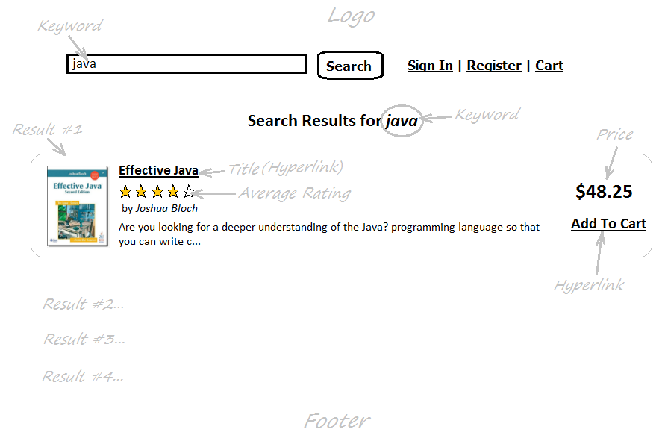
Implement Search Book Feature

Slide 2
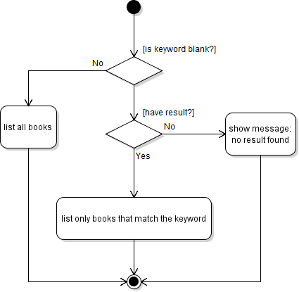
Activity Diagram

Slide 3
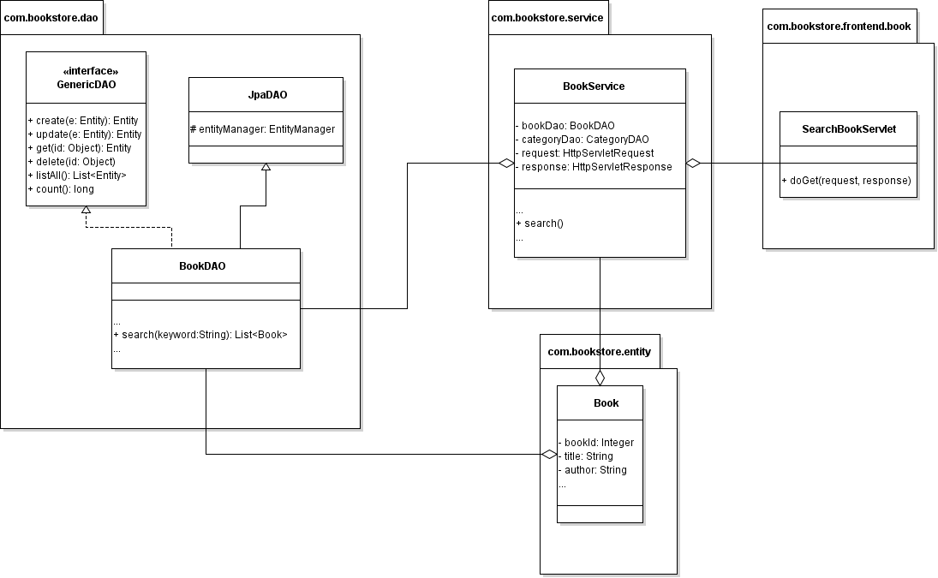
Class Diagram

Slide 4
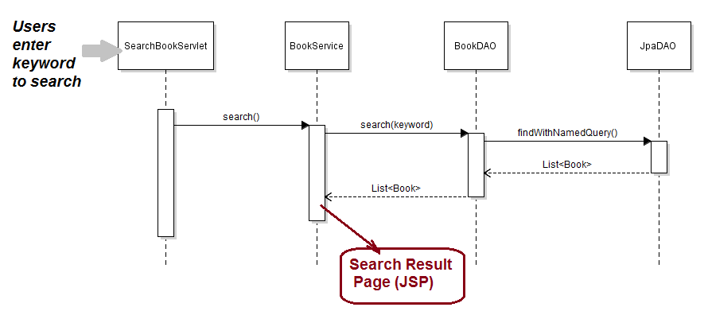
Sequence Diagram

Slide 5
Implement List New Books in Home Page
Task List:
Implement search() method in BookDAO + Write unit tests
Create SearchBookServlet
Update BookServices
Code Search Result Page (JSP)

